Slide 1

Module 4
Evaluating Model Performance
Notes:
Guidelines
Use section headers to chunk content in your presentation.
Use the same style of section header throughout your presentation.
Keep your title to no more than 2 lines.

Slide 2

Model Performance Evaluation Classification Problems
Notes:
Guidelines
Use a title slide at the beginning of your presentation. There are 9 variations of title slides to choose from.
If you will have a series of slideshows, we recommend using the same style of title slide for each presentation.
Keep your title to no more than 2 lines.
Do not change the font style or font size of the title or subtitle.

Slide 3
Performance Metrics
These are used to measure how good a model is.
Also called evaluation metrics and depend on the task:
Regression Metrics
Classification Metrics
Propensity Metrics

Slide 4
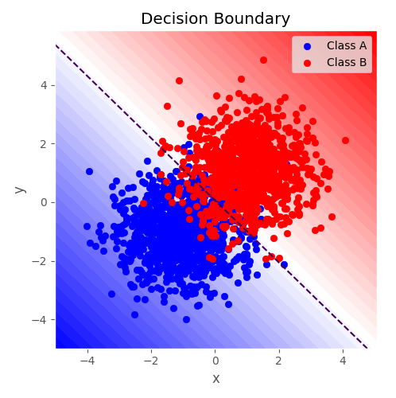
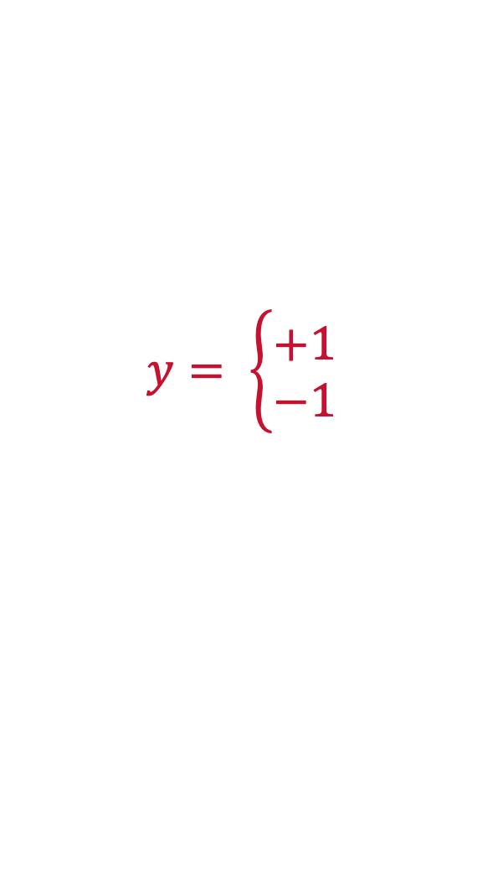
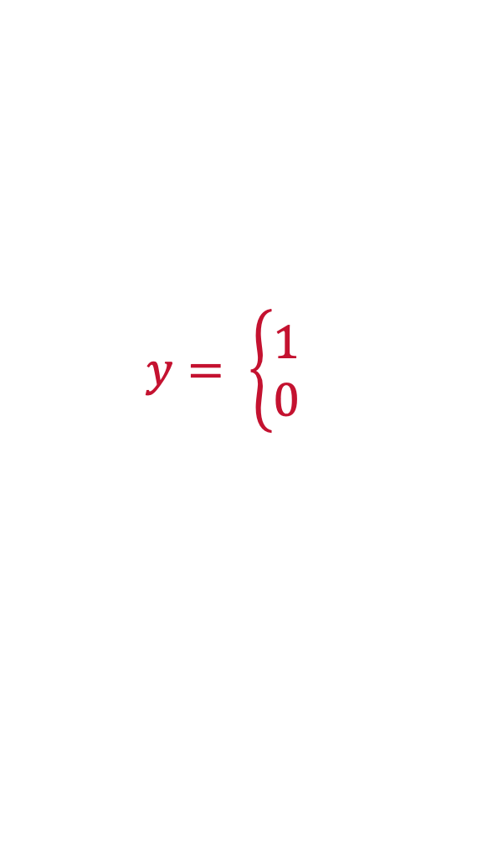
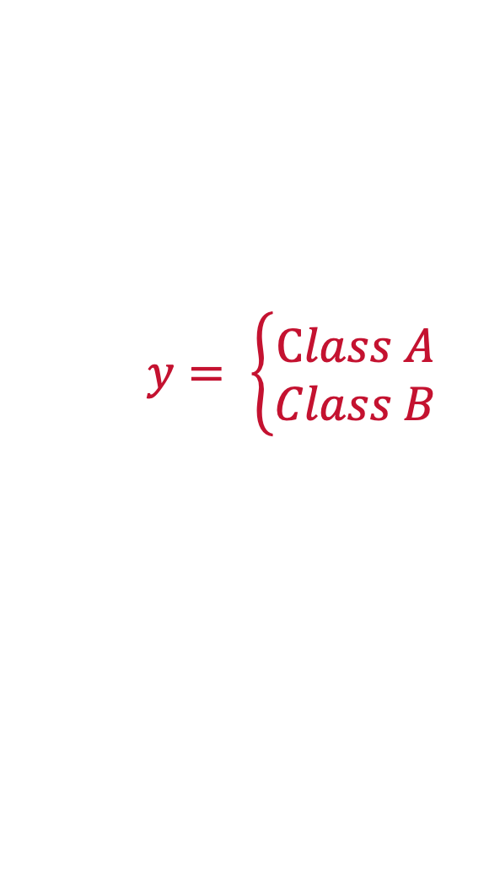
Classification
The goal of a classifier is to place an observation into a group
Problems can be binary, multi-class or multi-label
$$y= \left\{\begin{aligned}Class A \\ Class B\end{aligned}\right.$$
$$y= \left\{\begin{aligned}1 \\ 0\end{aligned}\right.$$
$$y= \left\{\begin{aligned}+1 \\ −1\end{aligned}\right.$$

Slide 5

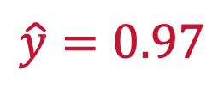
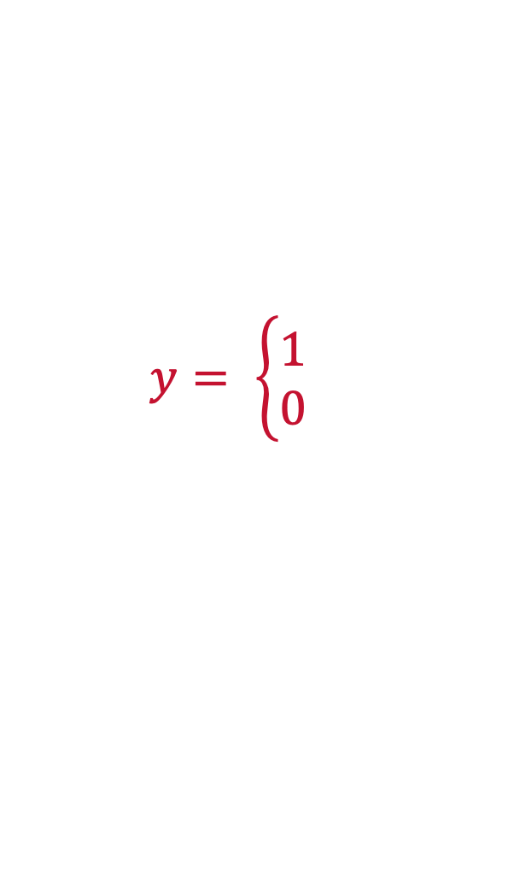
Classification Predicted Values
Predicted are generally probabilities (propensities)
The probabilities estimate $P(Y = 1)$
“1” is the generally the event of interest
$$y= \left\{\begin{aligned}1 \\ 0\end{aligned}\right.$$
$$\hat{y}=0.97$$

Slide 6
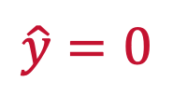
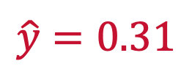
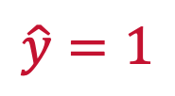
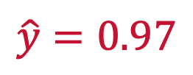

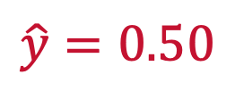
Classification Threshold
We assign a threshold to predict the event of interest “1”
Generally, 0.5 is chosen.
The threshold can be optimized
$$y= \left\{\begin{aligned}1 \\ 0\end{aligned}\right.$$
$$\hat{y}=0.97$$
$$\hat{y}=1$$
$$\hat{y}=0.31$$
$$\hat{y}=0$$
$$\hat{y}=0.50$$
$\hat{y}=0 or 1$ randomly

Slide 7
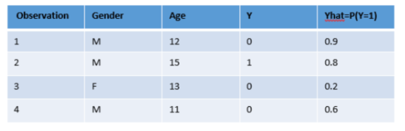
Classification Threshold
Threshold optimization can change performance

Slide 8
Benchmark for Classification
If you had no model what would the best prediction be?
The Naïve Model is to predict with the most common class

Slide 9

Classification Metrics
Metrics depend on type of classification: binary, multi-class/label
Must rely on an overall performance over all observations
$$y= \left\{\begin{aligned}1 \\ 0\end{aligned}\right.$$

Slide 10
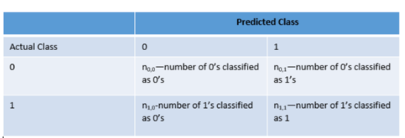
The Confusion Matrix
We can count the number of correct and incorrect classifications

Slide 11
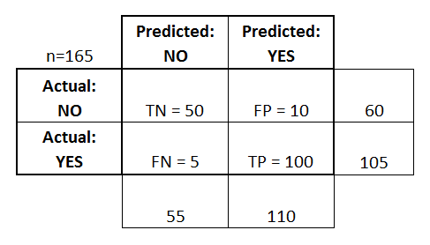




The Confusion Matrix
The confusion matrix gives a summary of overall performance
True Positives, True Negatives, False Positives and False Negatives
$$n_{0,0}$$
$$n_{0,1}$$
$$n_{1,0}$$
$$n_{1,1}$$

Slide 12
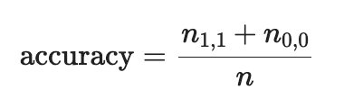
Accuracy
The accuracy metric measures number of obs predicted correctly
It is one of the most important classification metrics
$$n_{0,0}$$
$$n_{0,1}$$
$$n_{1,0}$$
$$n_{1,1}$$

Slide 13
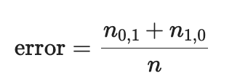
Misclassification Rate (Error)
Measures number of obs predicted incorrectly
$$n_{0,0}$$
$$n_{0,1}$$
$$n_{1,0}$$
$$n_{1,1}$$

Slide 14
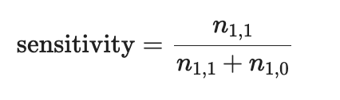
Sensitivity
The fraction of all 1’s that are classified (predicted) as 1’s.
$$n_{0,0}$$
$$n_{0,1}$$
$$n_{1,0}$$
$$n_{1,1}$$

Slide 15
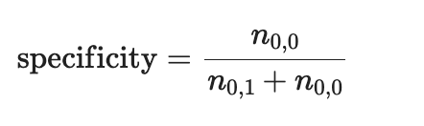
Specificity
The Fraction of all of the 0’s that are classified as 0’s.
$$n_{0,0}$$
$$n_{0,1}$$
$$n_{1,0}$$
$$n_{1,1}$$

Slide 16
Precision
The fraction of predicted values that are correct.
$$n_{0,0}$$
$$n_{0,1}$$
$$n_{1,0}$$
$$n_{1,1}$$

Slide 17
Python
Notes:
Guidelines
Use a title slide at the beginning of your presentation. There are 9 variations of title slides to choose from.
If you will have a series of slideshows, we recommend using the same style of title slide for each presentation.
Keep your title to no more than 2 lines.
Do not change the font style or font size of the title or subtitle.

